Slide 1
Strategic Management
Ms. Kanwalpreet Kaur Puri

Slide 2
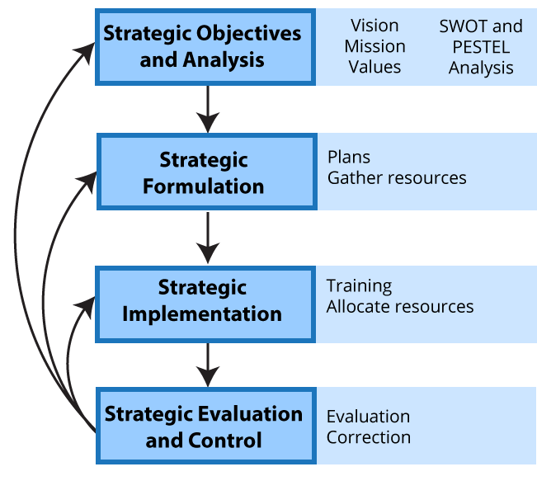
Introduction to Strategic Management

Slide 3
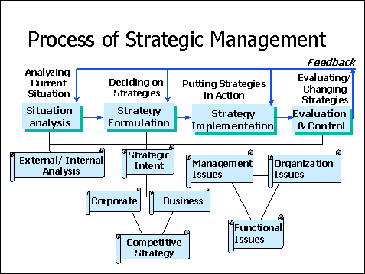
Process of Strategic Management

Slide 4
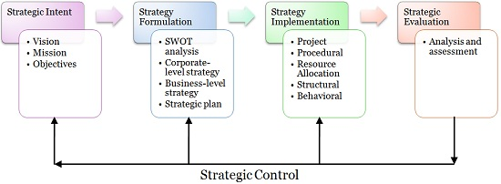
Process of Strategic Management

Slide 5
Defining the levels of strategic intent of the business:
Establishing vision
Designing mission
Setting objectives

Slide 6
Formulation of strategy
Performing environmental and organizational appraisal
Considering strategies
Carrying out strategic analysis
Making strategies
Preparing strategic plan

Slide 7
Implementation of strategy
Putting strategies into practice
Developing structures and systems
Managing behavioural and functional implementation

Slide 8
Strategic Evaluation and Control
Performing evaluation
Exercising control
Recreating strategies

Slide 9
Importance of Strategic Management
guides the company
assists the firm in becoming proactive
acts as a foundation for all key decisions
ensures the long-term survival
assists in the development of core competencies
to gain competitive advantage

